Slide 1


Human Recognition through Gait analysis
Submitted by : Apoorv Khare (9917102079)
Vivek Garg(9917102068)
Naman Wadhwa(9917102095)
Mentor: Dr. Parul Arora

Slide 2
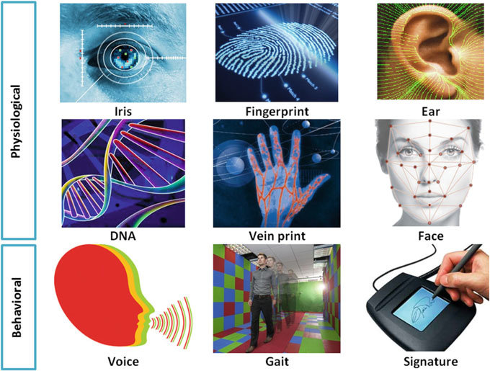
Introduction
Biometrics
The physiological characteristics are the physical human traits hand shape, facial recognition, fingerprints, iris scans, ear shapes, skin reflection, finger vein patter recognition and palm vein images,
Classifications of Biometrics & examples
Behavioural(measuring of the measurable patterns we see in our day to day life)
Physiological(related to specific measurements, dimensions and characteristics of your body)
Image Courtesy: https://www.researchgate.net/figure/Various-types-of-biometric-modalities_fig1_321082969

Slide 3
Motivation
It helps us to identify non-cooperating individuals whom we wish to identify.
The movie Mission: Impossible – Rogue Nation features gait analysis, in a scene where Benji Dunn must infiltrate a facility that uses gait analysis software as part of its security protocol. It was our first encounter in seeing such sophisticated surveillance system, Which created a great sense of motivation in the starting run of this project.
Aim of this Project
As today there are many ways by which forensic system can be tricked or fooled with fake biometric data. Thus there is need for improvement of forensic system or new methods in real world.
Here we are using Gait analysis as a new method in extracting biometric data and in recognition. As it is very difficult to fake someone’s walking style

Slide 4
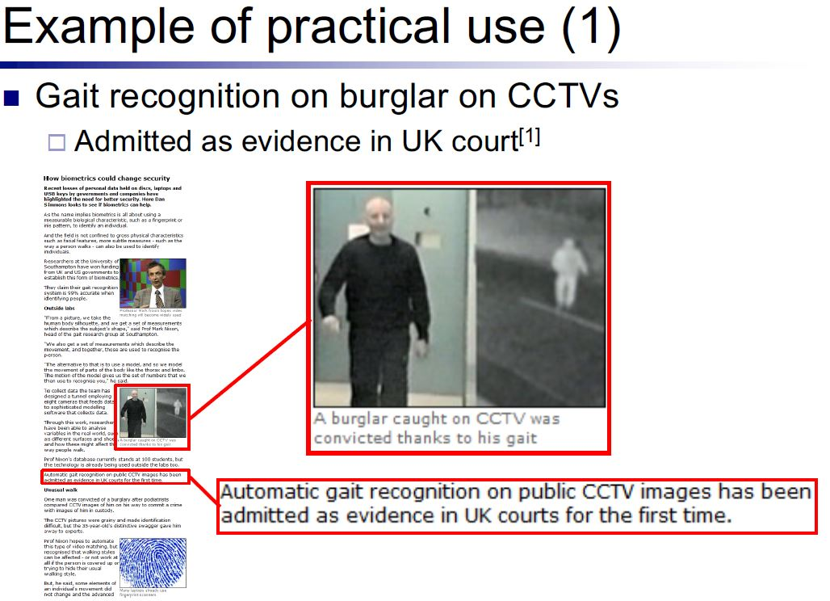
Applications
[1] http://news.bbc.co.uk/2/hi/programmes/click online/7702065.stm, ”How biometrics could change security,” BBC News, 31 Oct. 2008.

Slide 5
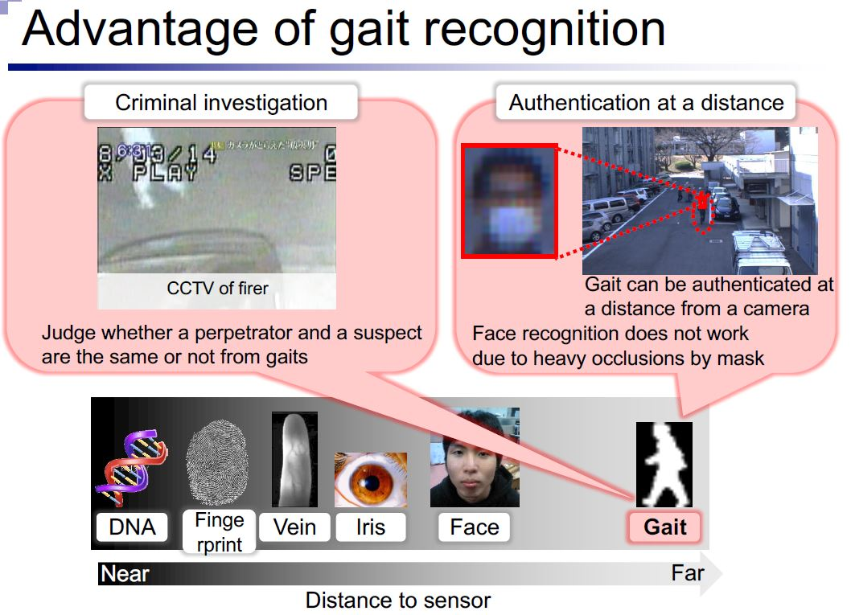

Slide 6
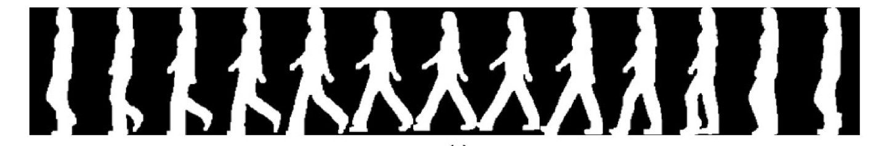
Gait: Introduction
Human Gait is defined as a translatory progression of the body as a whole produce by coordinated, rotatory movements of body segments.
Physiological methods cannot reliably recognize noncooperating individuals at a distance in the real world under changing environmental conditions
Gait, which concerns recognizing individuals by the way they walk is a relatively new biometric without the above disadvantage
The gait silhouettes for the extracted figure-centric images of a walking person(This is a gait of a person it shows a repeating pattern to it )

Slide 7
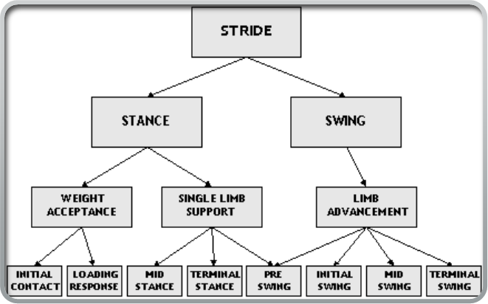
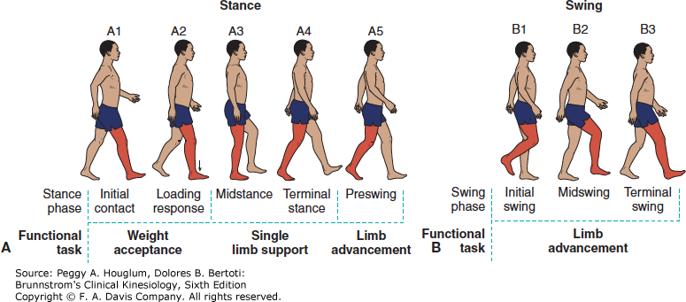
Gait and Stride
Human locomotion defined as running & walking, a single walking is a series of gait cycle
Single gait is called stride
Gait working principle
Weight Acceptance
Single Limb Support
Limb Advancement
The pattern repeated several times to produce human locomotion

Slide 8
Gait Methods
Model based approach
Model-based approaches are based on prior knowledge and often require both a structural and a motion model to capture both static and dynamic information of the gait.(can be made by primitive shapes and geometric shapes such as {cylinders, cones, blobs} which describes the edge of these body parts).
The structural models describes the body topology of a person such as stride length, height, hip, torso and knee.
In the other side, a motion model attempts to describe the dynamics of the motion of each body-part
Imad Rida1, Noor Almaadeed 1, Somaya Almaadeed1 Robust gait recognition: a comprehensive survey IET Research Journals 2015

Slide 9
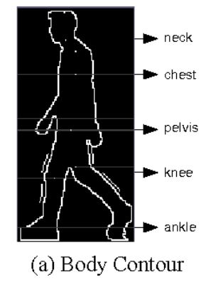
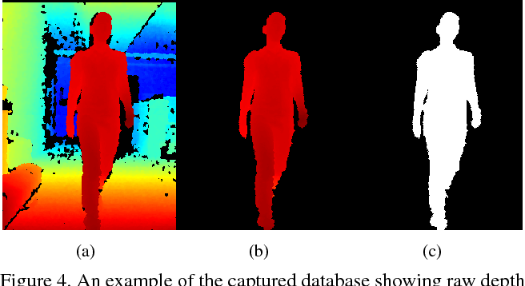
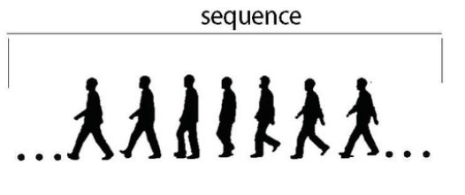
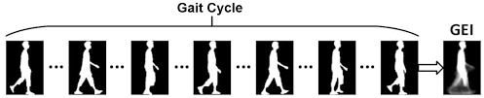
Model-free gait recognition
Model-free features are categorized as temporal and spatial. However, they can be further organized in four sub-categories:
Contours
Silhouettes
Energy
Depth
Contours
Depth
Silhouettes
Energy

Slide 10
Components to Extract the Gait
Contours: they have low computational cost but suffer from intraclass variations
Silhouettes: a whole silhouette is taken into consideration per subject. This can be advantageous because the errors of silhouette segmentation are avoided (A sequence of binarized black and white image with removal of unnecessary background images).
Energy: energy features attempt to extract the spatial and temporal information of the gait using a single and robust signature. The average image representation along a gait cycle is a good example (The energy generated by taking the average of every pixel, pixel here is which stays at the same position throughout the set of images of the same person).
Depth: instead of using solely color images, some works tried to exploit depth information based on devices such as Microsoft Kinect

Slide 11
Literature Survey
PAPER TITLE | AUTHORS | YEAR | CONTRIBUTION
Automatic Gait Recognition Based on Statistical Shape Analysis (IEEE TRANSACTIONS ON IMAGE PROCESSING) | liang Wang, Tieniu Tan, Senior Member, IEEE, Weiming Hu, and Huazhong Ning | 2003 | The development of computer vision techniques has also assured that vision-based automatic gait analysis can be gradually achieved. Increasing the applicative possibility.
A Framework for Evaluating the Effect of View Angle, Clothing and Carrying Condition on Gait Recognition9(The 18th International Conference on Pattern Recognition (ICPR'06)) | Shiqi Yu, Daoliang Tan, and Tieniu Tan | 2006 | Learning the set up for gait data collection
Individual Recognition Using Gait Energy Image | Ju Han, Student Member, IEEE, and Bir Bhanu, Fellow, IEEE | 2006 | Feature extraction through Gait energy image
The OU-ISIR Gait Database Comprising the Large Population Dataset and Performance Evaluation of Gait Recognition(IEEE TRANSACTIONS ON INFORMATION FORENSICS AND SECURITY) | Haruyuki Iwama, Mayu Okumura, Yasushi Makihara, and Yasushi Yagi, Member, IEEE | 2012 | Getting to realize the dataset, on the no. of data set and using it accordingly
A Survey on Gait Recognition(ACM Computing Surveys.) | CHANGSHENG WAN, LI WANG and VIR V. PHOHA, | 2018 | First, we got to know about history of gait recognition. Early gait recognition systems are built on video. In the past several years, the industry also built gait systems using floor sensors, accelerometers, and wave radars.

Slide 12
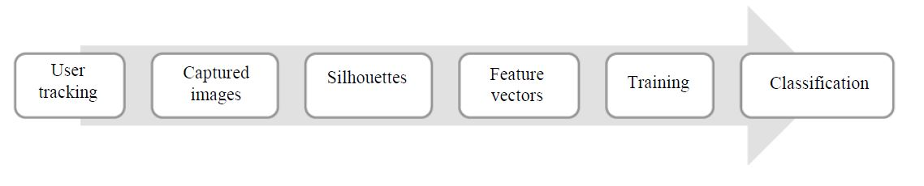
Flow Chart of our Approach

Slide 13
Gait Database
Database is important in Evaluating the robustness of the gait recognition , because walking conditions depend on time often differ between gallery and probe.
For instance, the clothing and carrying conditions when walking along a street in a suit with a bag while on business can differ from those when strolling empty-handed in casual clothes during leisure time.
The second considerations important to ensure statistical reliability of the performance evaluation.
There are two considerations in constructing a gait database:
(1) the variation in walking condition eg speed, view clothing
(2) the number and diversity of the subjects

Slide 14
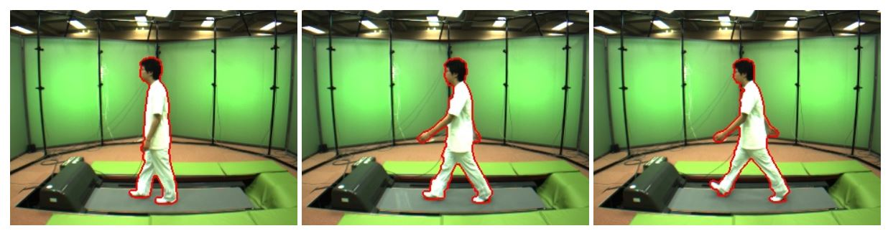
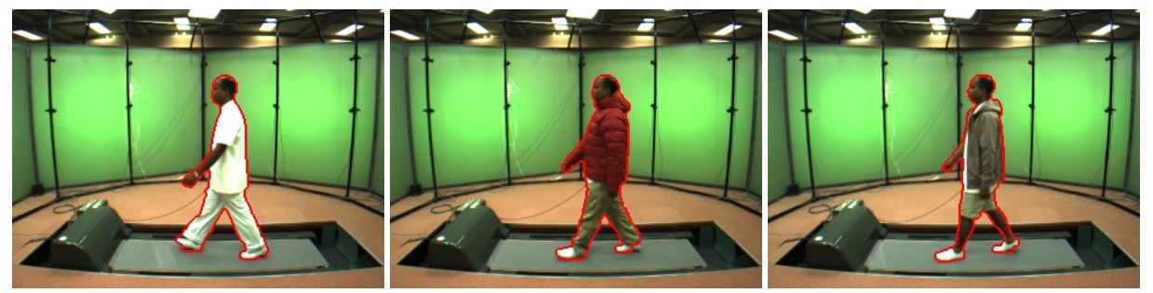
OU-ISIR Biometric Database (Gait Database Treadmill Dataset)
The OU-ISIR Gait Database is meant to aid research efforts in the general area of developing, testing and evaluating algorithms for gait-based human identification.
The datasets are basically distributed in a form of silhouette sequences registered and size-normalized to 88 by 128 pixels size.
Treadmill dataset A -Speed variation-
Treadmill dataset B -Clothes variation-

Slide 15
Types of Gait Recognition
Fixed-view: gait recognition where both probe and gallery gaits are captured from the same view;
Cross-view: gait recognition where the probe and gallery gait are captured from different views; and
Multi-view: gait recognition where the probe gait under a specific view are recognized by gallery gaits from multiple view
DATA SET MAIN
GALLERY: It is a collection of biometric templates that form the search dataset.
PROBE: It is a collection of biometric templates that need to be recognized or identified by matching against the gallery.

Slide 16
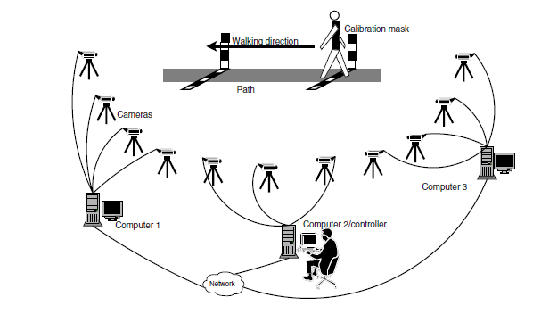
SETUP FOR DATA COLLECTION

Slide 17
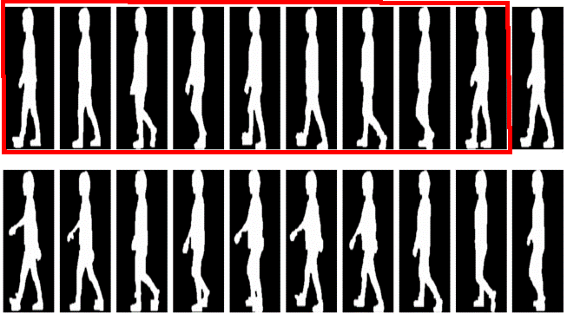
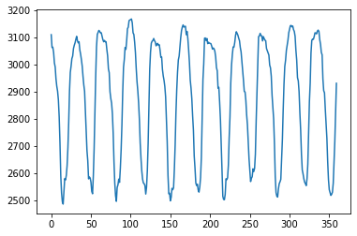
Gait Cycle
Defined as the period from heel strike to the next heel strike of the same limb
Human gait can be generally treated as a periodic motion and expressed using the gait cycle or stride
A complete gait period consists of two steps, where each step denotes motion between successive heel strikes of opposite feet
It aims to discriminate individuals by the way they walk
It is unobtrusive
It depends on how the silhouette shape of an individual changes over time in image sequence

Slide 18
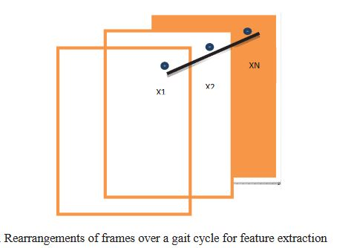
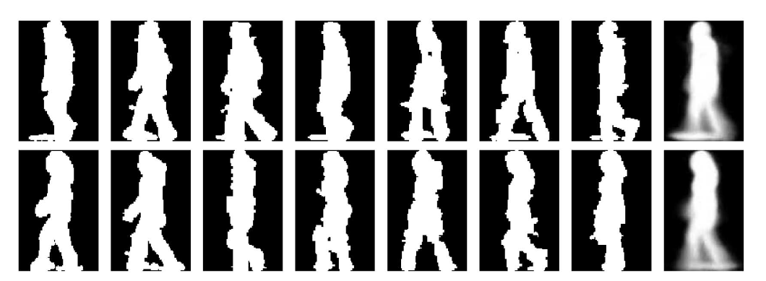
GAIT ENERGY IMAGE (GEI)
Spatio-temporal gait representation, called Gait Energy Image (GEI), to characterize human walking properties for individual recognition by gait.
Gait Energy is the sum of the walking silhouette divided by the number of images
GEI is the useful representation with superior selective power and strength
In one gait cycle, there are N numbers of frames, therefore for one pixel taken from each frame (x1,x2,x3,,,xi,....,xN), we get N number of pixels in a vector
ENERGY IMAGE

Slide 19
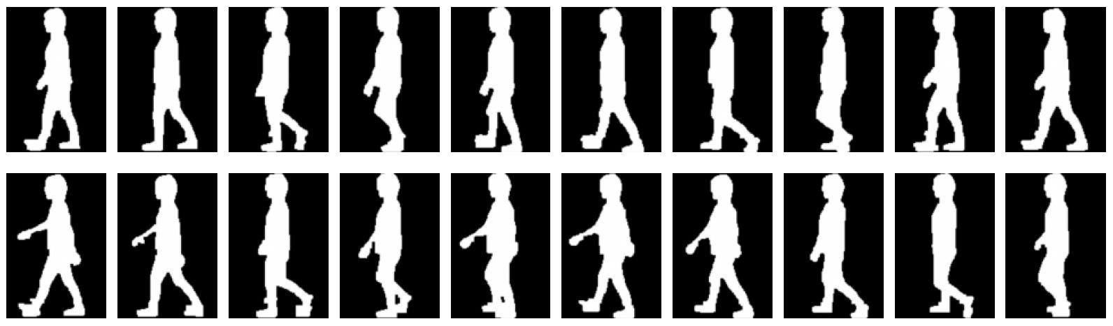
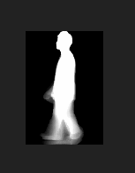
The result obtained from Gait Energy Image Process.

Slide 20
Implementation
Importing libraries like numpy, matplotlib.pyplot and pandas.
Loading raw datset in the jupyter notebook using OS library.
Calculation of Gait Cycle
Calculation of Gait Energy Image using numpy arrays and Gait Cycle
Creating Dataset using pandas and numpy libraries
Importing the Dataset.
Dataset handling and removing noises using pandas in python.
Importing the sklearn.neighbors library and fitting K-Nearest Neighbours to training
data.
Importing the sklearn.tree library and fitting Decision Tree to training data.
Importing the sklearn.ensemble library and fitting Random Forest to training data.
Testing the classifiers of different models to the testing data (new data).
Plotting the confusion matrix for analyzing correct/incorrect results.
Plotting ROC for analyzing the prediction ability of models.
Plotting the bar graphs showing comparison of accuracies of different
models.

Slide 21
Result Analysis
In this project, we have used 3 different type of algorithms in Classification of Dataset.
They are:-
kNN(k-Nearest Neighbours)
Decision Tree
Random Forest
Also we have used method like ROC and Confusion matrix methods to diagnose the ability of the classifier in prediction.

Slide 22
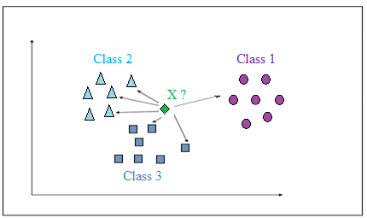
kNN(k-Nearest Neighbour)
The k-Nearest Neighbors (k-NN) is a popular method of classification in machine learning.
An object is classified by a majority vote of its neighbors, with the object being assigned to the class most common among its k nearest neighbors. This value is the average of the values of its k nearest neighbors.
It classifies test data by finding the most similar data points in the training data, and making an educated guess based on their classifications.

Slide 23
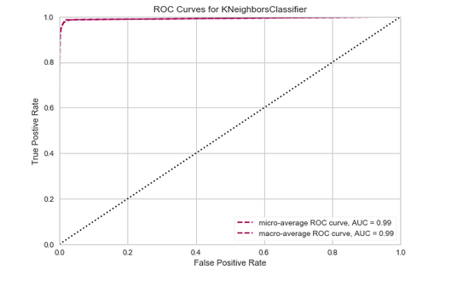
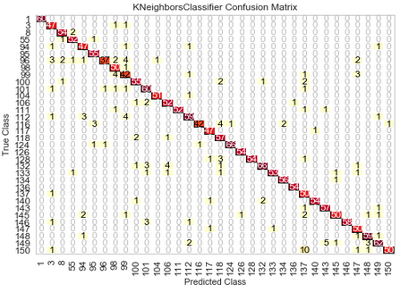
Accuracy obtained-92.21%

Slide 24
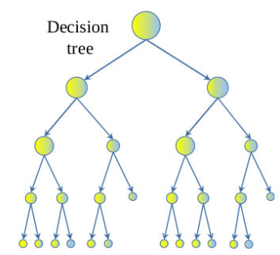
Decision Tree
A Decision tree is a decision support tool that uses a tree-like model.
It is one way to display an algorithm that only contains conditional control statements.

Slide 25
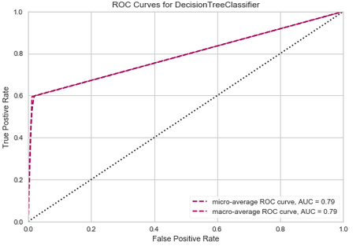
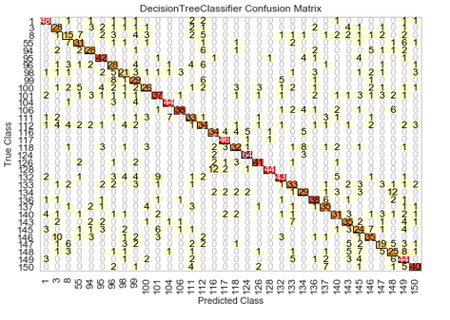
Accuracy obtained – 60%

Slide 26

Random Forest
A Random Forest is a data construct applied to machine learning that develops large numbers of random decision trees analysing sets of variables.
This type of algorithm helps to enhance the ways that technologies analyse complex data.
Random forest builds multiple decision trees and merges them together to get a more accurate and stable prediction.

Slide 27
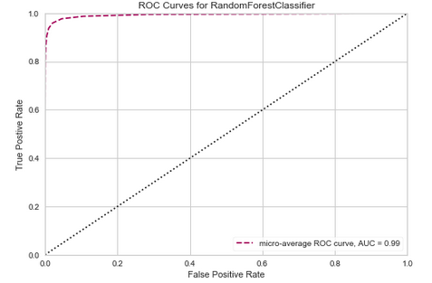
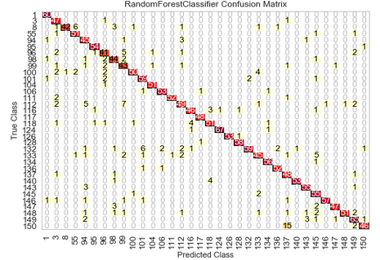
Accuracy obtained:-78.8%(without n_estimators) Accuracy obtained:-90.12%(with n_estimators=30)

Slide 28
Conclusion and Future Scope
From this Project Gait Recogniton , we get to know
GEI is an effective and efficient gait representation as the classifier projected great results.
The proposed recognition approach achieves highly competitive performance with respect to the published major gait recognition approaches.
Also we would like to expand our database and include many more variation like Age, Gender, Clothing, video capturing Environment, etc.
To implement Model based feature extraction techniques on dataset.
Using CNN(Convolution neural network) and RNN(Recurrent neural network) for training and classification for more improved accuracy.
To work on other feature extraction techniques like Gait Gaussian Image (GGI), Gait Entropy Image (GEnI) .

Slide 29
References
[1]Yu Shiqi, Daoliang Tan, Tieniu Tan, "A framework for evaluating the effect of view angle clothing and carrying condition on gait recognition", Pattern Recognition 2006. ICPR 2006. 18th International Conference on, vol. 4, 2006.
[2] H. Iwama, M. Okumura, Y. Makihara, Y. Yagi, "The OU-ISIR gait database comprising the large population dataset and performance evaluation of gait recognition", IEEE Trans. Inf. Forensics Secur., vol. 7, no. 5, pp. 1511-1521, 2012.
[3]W. Kusakunniran, "Recognizing gaits on spatio-temporal feature domain", IEEE Transactions on Information Forensics and Security, vol. 9, no. 9, pp. 1416-1423, 2014
[4]Zhang, E.; Zhao, Y.; Xiong, W. Active energy image plus 2dlpp for gait recognition. Signal Process. 2010, 90, 2295–2302
[5]J. Han, B. Bhanu, "Individual recognition using gait energy image", IEEE Trans. on Pattern Anal. Mach. Intell., vol. 28, pp. 316-322, 2006
[6] Changsheng Wan , Li Wang , Vir V. Phoha, “A Survey on Gait Recognition ,” ACM Computing Surveys (CSUR), vol.51 n.5, p.1-35, January 2019
[7] L.Wang, T.Tan, W.Hu, and H.Ning, “Automatic gait recognition based on statistical shape analysis ,” IEEETransIP,12(9):1120-1131,2003.
[8] Imad Rida, Noor Al-maadeed, and Somaya Al-maadeed, “Robust gait recognition: a comprehensive survey ,” IETBiometrics, 2018. DOI: 10.1049/iet-bmt.2018.5063
[9] Li, S.Z., & Jain, A, “Encyclopedia of biometrics,” Berlin: Springer Publishing Company, Incorporated (2015).
[10] Arora, P., Srivastava, S.: ‘Gait recognition using gait Gaussian image’. Int. Conf. Signal Processing and Integrated Networks, 2015, Noida, India, February 2015, pp. 791–794

Slide 30
THANK YOU!

